Slide 1
West Manor Elementary
Notes:
Good Morning/Afternoon! Today we begin the process of planning our school’s budget for FY23. I know we are all here for the same reason and that is ensuring success for all (enter school name) students. This meeting is to provide an overview of the draft budget and for you to give feedback on the draft budget.

Slide 2
Norms
This is a meeting of the GO Team. Only members of the team may participate in the discussion. Any members of the public present are here to quietly observe.
We will follow the agenda as noticed to the public and stay on task.
We invite and welcome contributions of every member and listen to each other.
We will respect all ideas and assume good intentions.

Slide 3
GO Team Budget Development Process
YOUR SCHOOL STRATEGIC PLAN…
is your roadmap and your role.
It is your direction, your priorities, your vision, your present, your future.
Step 1: Data Review
Step 2: Strategic Plan Review
Step 3: Budget Parameters
(Strategic Priorities)
Step 4: Budget Choices
Notes:
Today I will provide an overview of the budget allocations for FY23. We will begin the work of funding the strategic priorities we agreed upon during our strategic review meeting. (IF YOU HAVE NOT DECIDED ON YOUR PRIORITIES, YOU WILL SAY – WE WILL DECIDE ON OUR PRIORITIES AND THEN DISCUSS ALLOCATING FUNDS TO ADDRESS THOSE PRIORITIES).

Slide 4
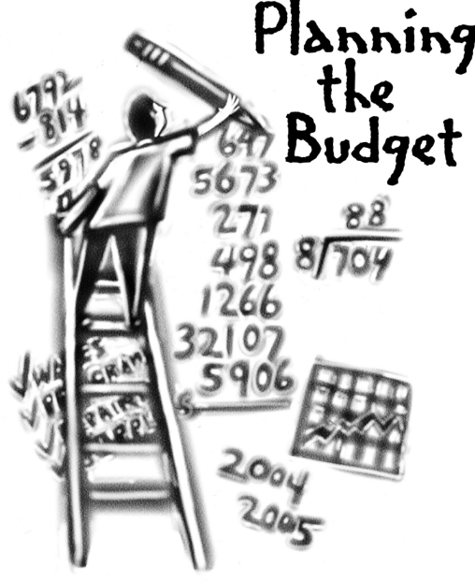
Overview of FY ‘25 GO Team Budget Process
Step 1 Review and Update Strategic Plan and Rank Strategic Priorities
By end of Fall Semester
Step 6 Principals: HR Staffing Conferences Begin
February 26–March 1
Step 3 GO Team Initial Budget Session: Allocation
January 17 – early February
Step 7 GO Team Final Budget Approval Meeting
Budgets Approved by March 15
Step 5
GO Team Feedback Session: Draft Budget Presented & Discussed February – multiple meetings, if necessary
Step 4 Principals: Associate Supt. Discussions and Review
February (supports needed, specific challenges, coaching)
Step 2 Principals: Workshop FY 25 Budget
January 17
GO Teams are encouraged to have ongoing conversations

Slide 5
Budget Allocation Meeting
What
The first GO Team meeting is when the principal will provide an overview of the budget allocation for GO Team members and the general public.
Why
This meeting provides an opportunity for the principal and GO Team to ensure alignment on the school’s key strategic priorities, gain a deeper understanding of the budget allocation, and provide input to drive the direction of the draft budget.
When
End of January- Early February

Slide 6
FY25 Budget Development Process
Principal’s Role
Design the budget and propose operational changes that can raise student achievement
Flesh out strategies, implement and manage them at the school level
Focus on the day-to-day operations
Serve as the expert on the school
Hire quality instructional and support personnel
The GO Team’s Role
Focus on the big picture (positions and resources, not people)
Ensure that the budget is aligned to the school’s mission and vision and that resources are allocated to support key strategic priorities

Slide 7
West Manor IB World School
SMART Goals
Increase the % of grades 3-5 students scoring proficient or above on Milestones/ MAP in reading by 3%
Increase the % of grades 3-5 students scoring proficient or above on Milestones/MAP in math by 3%
Increase the percentage of students with 10 or less absences by 3%
APS Strategic Priorities & Initiatives
School Strategic Priorities
School Strategies
Fostering Academic Excellence for All
Data
Curriculum & Instruction
Signature Program
1.
3.
1A. Implementation of an intervention block to reduce gaps in learning
1B. Employ a literacy block with phonics for grades k-2
1C. Create PLC planning time for teachers to internalize standards and plan for instruction
Increase student phonic awareness and create early readers
Increase student knowledge in numbers and operations domain
Increase student multiplication skills
Building a Culture of Student Support
Whole Child & Intervention
Personalized Learning
Increase student attendance and decrease suspension rate
TBD: Create an attendance team to monitor and address attendance concerns, Create a Care Team to address student needs
TBD: Utilize SLC practices and restorative justice with the Counselor to reduce suspensions
Equipping & Empowering Leaders & Staff
Strategic Staff Support
Equitable Resource Allocation
Increasing Teacher knowledge of Standards
Increase Teacher knowledge of IB Program
TBD: Monthly IB training for staff, Professional development individualized around teacher needs in reading and math, training for phonics program (Fundations)
Ongoing PD for SEL, restorative practices, and trauma
Creating a System of School Support
Collective Action, Engagement & Empowerment
TBD: Conduct data meetings in PLC, with parents and students. Students will also have goal setting meetings with teachers
--Increase Parent Liaison and Social Worker positions to full time to support the needs of students and parents
Improve stakeholder knowledge of school data and how to assist
Provide support to students and stakeholders in need

Slide 8
Updates to the
Strategic Plan
No changes to Strategic Plan
1.Increase student phonic awareness and create early readers
2 Increase student knowledge in numbers and operations domain
3. Increase student multiplication skills
4. Increase student attendance and decrease suspension rate
5.Increasing Teacher knowledge of Standards
Increase Teacher knowledge of IB Program
7. Improve stakeholder knowledge of school data and how to assist
9. Provide support to students and stakeholders in need

Slide 9
FY24 Budget Parameters
FY24 School Priorities | Rationale
Improve percent of students achieving at proficient level on Milestones assessment | Provide instruction to prepare students for their next educational level and remove instructional gaps caused by Covid
Implement International Baccalaureate program model | Provide rigor and ensure our students think globally
Ensure a welcoming parent friendly environment | increase parent involvement to strengthen the partnership between school and home
Notes:
Review the priorities that the GO Team has developed and the rationale for these priorities. Feel free to copy this slide if you have more than 3 priorities to account for.

Slide 10
FY24 Budget Parameters
FY24 School Priorities | Rationale
Maximize the intervention block daily | Dedicated time for students to receive specific interventions and/or enrichment.
Notes:
Review the priorities that the GO Team has developed and the rationale for these priorities.

Slide 11
Discussion of
Budget Allocation

Slide 12
Executive Summary
This budget represents an investment plan for our school’s students, employees and the community as a whole.
The budget recommendations are tied directly to the school’s strategic vision and direction.
The proposed budget for the general operations of the school are reflected at $_4,298,075
This investment plan for FY25 accommodates a student population that is projected to be 244__ students, which is a increase/decrease of _22__ students from FY24.
Notes:
Here’s a few highlights for our budget this year – read executive summary

Slide 13
FY2025 TOTAL SCHOOL ALLOCATIONS
School | West Manor Elementary School
Location | 2569
Level | ES
FY2025 Projected Enrollment | 244
Per Pupil | $17,615
Total Earned | $4,298,075
Notes:
Additionally, we received money for signature programming, turnaround, Title I and FTE Allotments.

Slide 14
SSF Category | Count | Weight | Allocation
Base Per Pupil | 244 | $5,324.48 | $1,301,491
Grade Level |  |  | $277,100
Poverty | 166 | 0.47 | $416,157
Concentration of Poverty |  | 0.03 | $17,884
EIP/REP | 47 | 1.05 | $263,232
Special Education | 26 | 0.05 | $6,934
Gifted | 33 | 0.70 | $123,215
Gifted Supplement | 0 | 0.70 | $0
ELL | 25 | 0.20 | $26,670
Small School Supplement | 206 | 0.25 | $274,700
Incoming Performance | 0 | 0.10 | $0
Baseline Supplement |  |  | $11,026
Transition Policy Supplement |  |  | $0
Capacity |  | 0.25 | $0
Total SSF Allocation |  |  | $2,718,409

Slide 15
Additional Earnings
Signature |  |  | $232,410
Turnaround |  |  | $0
Title I |  |  | $154,123
Title I Holdback |  |  | -$16,013
Title I Family Engagement |  |  | $6,672
Title I School Improvement |  |  | $0
Title I Behavior |  |  | $0
Title IV Bridge |  |  | $0
Field Trip Transportation |  |  | $9,237
Dual Campus Supplement |  |  | $0
District Funded Stipends |  |  | $10,200
Flex (New!) |  |  | $132,339
Total FTE Allotments | 12.05 |  | $1,050,697
Total Additional Earnings |  |  | $1,579,665
Total Allocation |  |  | $4,298,075

Slide 16
What’s Next?
January
GO Team Budget Allocation Meeting (Jan. 17th-late February)
February
One-on-one Associate Superintendent discussions
Cluster Planning Session (positions sharing, cluster alignment, etc.)
Program Manager discussions and approvals
GO Team Feedback Meeting(s) before principal’s staffing conference
HR Staffing Conferences (February 26 – March 1)
March
Final GO Team Approval Meeting (AFTER your school’s Staffing Conference and BEFORE Friday, March 15th)
Notes:
In February, we will meet again to discuss how the school’s budget has been allocated to support the programmatic needs and FY23 key strategic priorities.
If think we need to continue our budget conversations, we will schedule additional meetings. My goal is to make sure your voices are reflected in our school’s budget.
I will also be meeting with my Associate Superintendent, program managers and other key leaders to go over our budget and to make sure the school is meeting the standards of service and appropriately staffing.
During the week of Feb. 24th -March 2nd , HR Staffing Conferences will be held. At this meeting, I will present my plan for staff utilization, resource distribution and plan for staffing implications.
We will need to approve the budget at the ________ meeting.

Slide 17
Questions?
Thank you for your time and attention.
Notes:
IF YOU FEEL YOUR TEAM IS READY TO APPROVE THE DRAFT BUDGET, PLEASE DO SO. PLEASE REMIND THEM THAT YOU MAY NEED TO MEET WITH THEM AGAIN, IF THERE ARE CHANGES FROM YOUR MEETINGS WITH DISTRICT LEADERSHIP. LET THEM KNOW YOU WILL KEEP THEM INFORMED!!

